Slide 1
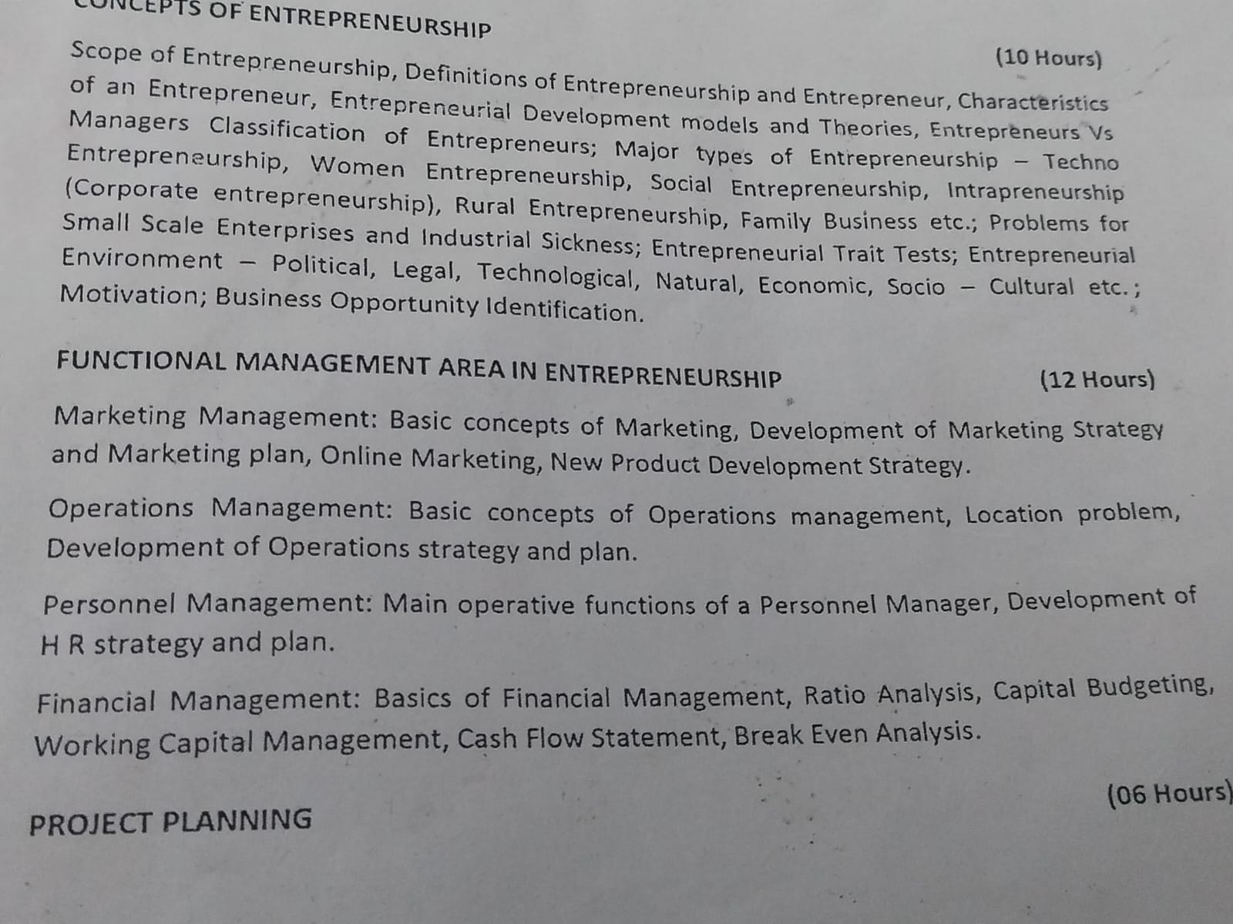
REFER MARKETING, OPERATIONS AND PERSONNEL MANAGEMENT PPTS OF PEEBM.

Slide 2
Marketing continuation
IIE

Slide 3
Online marketing
Digital marketing, also called online marketing, is the promotion of brands to connect with potential customers using the internet and other forms of digital communication. This includes not only email, social media, and web-based advertising, but also text and multimedia messages as a marketing channel.

Slide 4
Role of online marketing
A digital marketer is responsible for getting the word out in the market about a brand. They use a wide variety of digital channels to build brand awareness and generate leads. The digital channels include the company's website, and social media platforms such as YouTube, Facebook, Instagram and Twitter, and others.
Advantages- ?

Slide 5
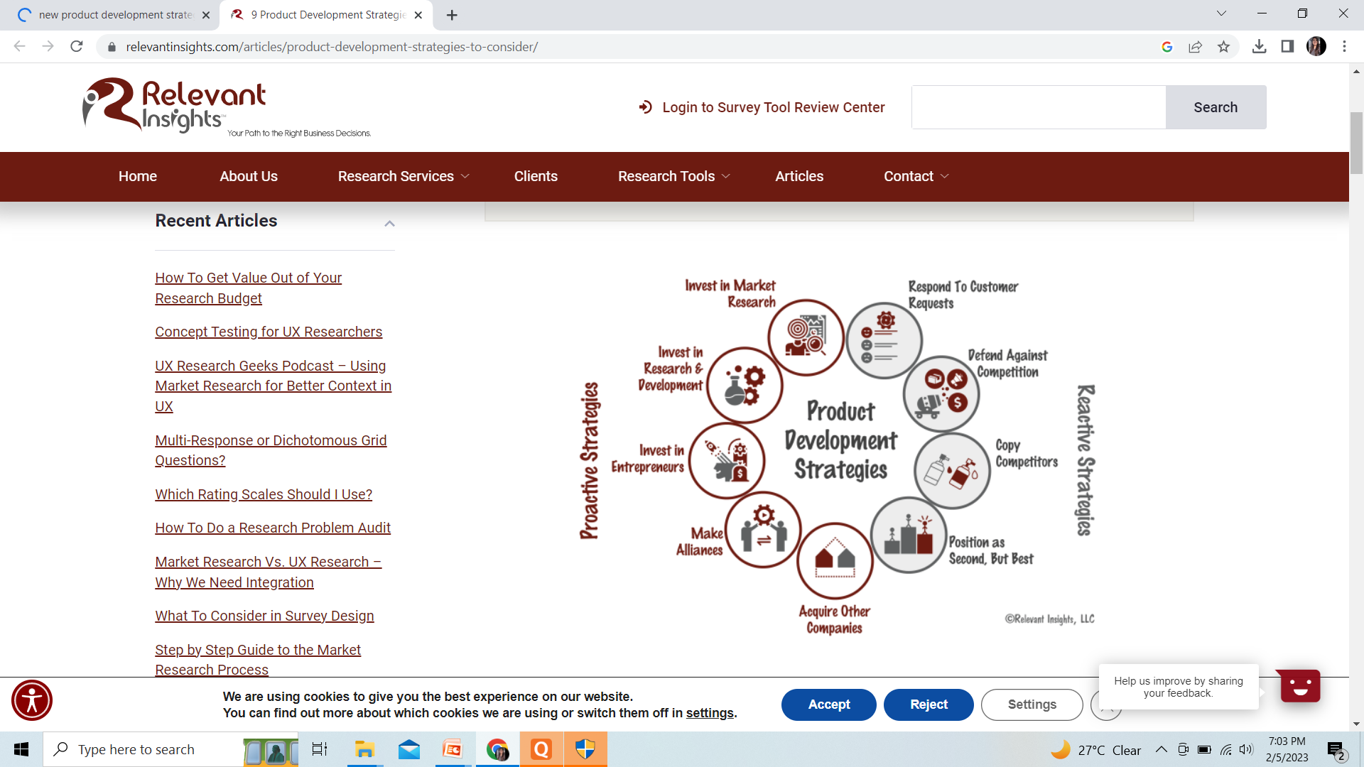
New product development strategy

Slide 6
